Slide 1
1. Establish the Context 2. Risk assessment: A. risk identification B. risk analysis / evaluation 3. Risk Treatment 4. Opportunity review
Process – Project Risk Management
RealTrack
Process steps
I RISK REVIEW
1. Project Context Card
2. Risk Assessment
A. Check list
B. Risk Register – risk, cause, consequece, probability & impact
3. Risk Register – risk treatment section
4. Opportunity Register
II. OPPORTUNTYREVIEW
Massive Download – is necessary for next step , which is the Portfolio Risk Management

Slide 2
RealTrack Deliverables
MVP 1
MVP 2
1. Project Context Card 2. Risk Assessment - Check list
3. Risk Assessment – Risk Register, risks list
4. Risk Register – Data-form
5. Opportunity Register
6. Massive data download
1. Project Context Card template editing for Risk Owner 2. Check list template editing for Risk Owner
3. Opportunity Register template editing for Risk Owner
4. Dashboard and charts ... ???
Template editing will be handled in back-end via Support team (1 week response avg)
Start date: 23-april-18
Go-live : end of June, pull-in requested
Go-live : tbc

Slide 3
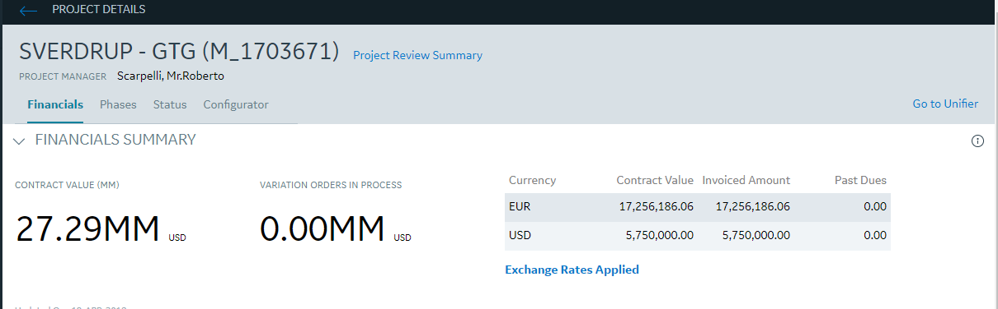
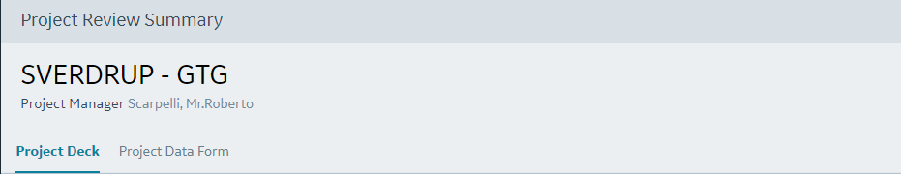
Overall UX
To access the Project Risk Register the user shall open the Project Details page and click on the ‘Project Risk Management’:
Project Risk Management
Project Risk Management

3 tabs. Context Card shall be default tab
Context Card
Risk Register
Opportunity Register

Slide 4

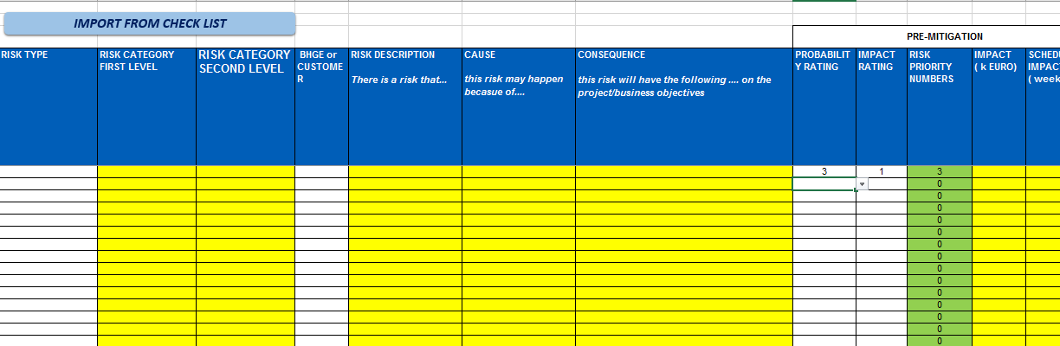

Project Risk Management UX
In the Risk Register tab within the Project Risk Management, the PM role users shall see the Check list hyperlink and the command ‘Import from Check List’:
Project Risk Management

Context Card
Risk Register
Opportunity Register
CHECK LIST
Import from Check List
Each line shall have the Edit icon (similar to Installation Dashboard)

Slide 5
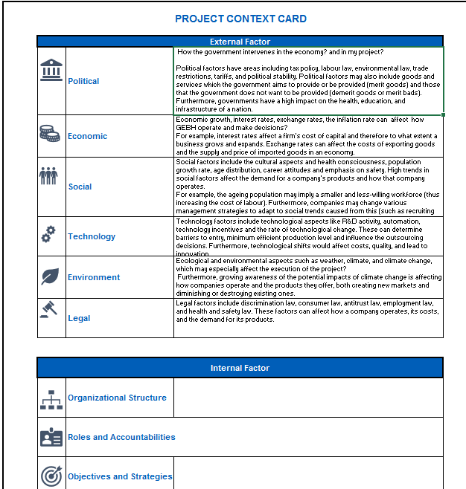
MVP1 1. Project Context Card
1
2
3
Need a form as in the picture aside split in 2 main sections (External Factor and Internal Factors) and 5 or more paragraphs with text.
1 – Icons are defined by a super user : list is in the excel.
2 – text defined by a super user: list is in the excel.
3 - text box where PM will enter free text : number of characters is unlimited
The form might change to adapt to business needs and business changes: development shall be dynamic and easy to be modified, even thoug from back end
Functionalities:
PM roles will edit column 3 with text , will save
TO be downoladed in Excel
Log will show date and time when saved and user name.
The card is stand alone: no integration within RealTrack or external of RealTrack
USERS ACCESS TO WIDGET:
PM - the PMs need to have the capability to input manually free text in column 3 and save.
All other roles - Read only access
log
Save

Slide 6
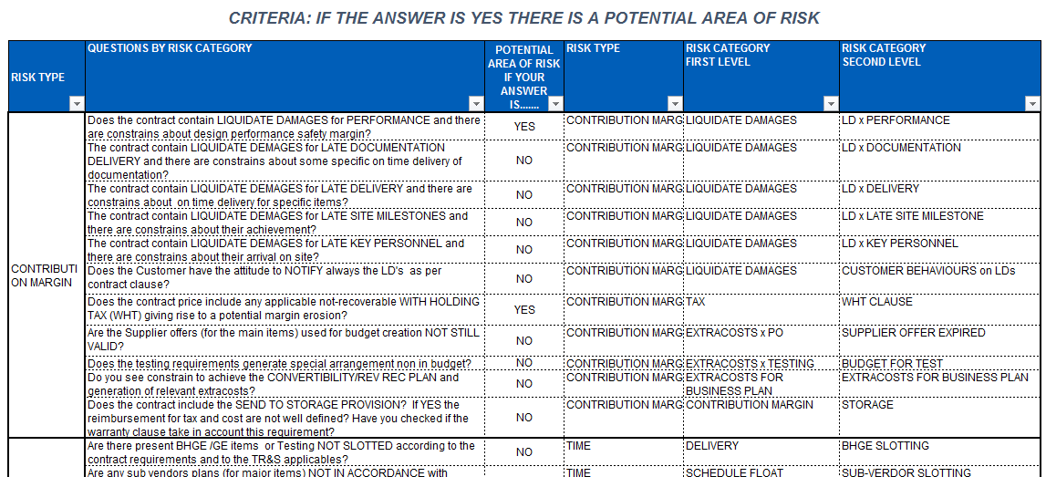
MVP1 2. Check List
This is a tool to help the PM in identifying all possible area of risks in the project.
It is a standard table with a list of questions grouped by Risk Type. The list of questions may change over time, so the table shall be editable in a simple and quick way from back end-
4
5
6
1
2
Functionalities:
PM will edit column 3 (drop down list : ‘Y’ or ‘N’ and will save.
Log will show date and time when saved and user name.
The card will populate the Risk Register view : if a YES is input in column 3 a row will be visible in the Risk register → columns 4, 5 and 6 to be visible in the Risk register.
USERS ACCESS TO WIDGET:
PM Role - the Pm needs to input manually from a drop down list (N, Y) in col 3.
All other roles - Read only mode ... tbc
3
Save
log

Slide 7
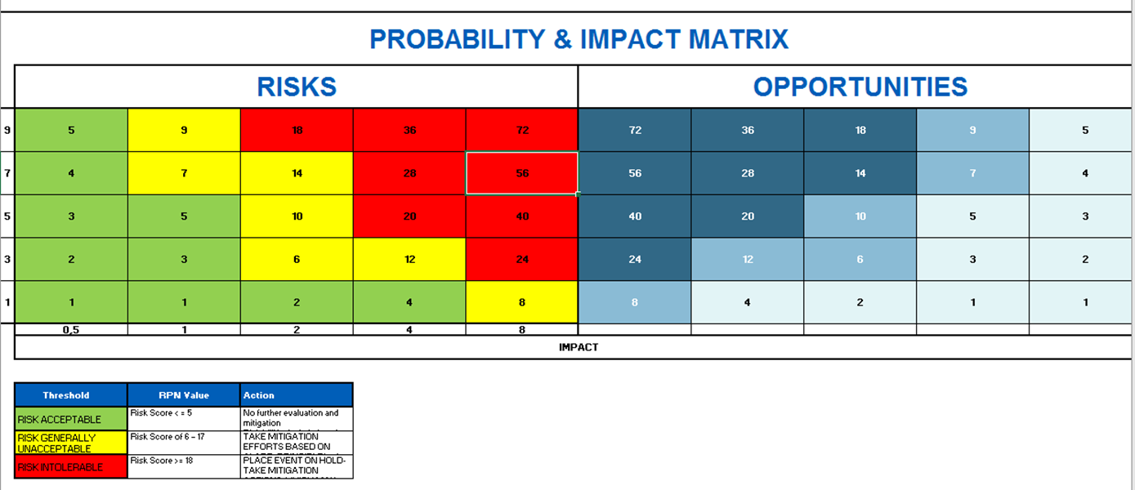
MVP1 3. Risk Register –
It is a table with the list of risks identified for the project and used for the risks analysis and mitigation.
Each row corresponds to one risk.
The PM imports the risks identified (marked as Y) from the Checklist and can add new lines. In addition, edits most of the columns of the register by using a separate data-form.
White columns = drop down list
Yellow columns = free text
Green columns = calculated .
Refer to excel prototype for exact values and logics.
Updated on: dd/mon/yyyy
Saved by: ....
Functionalities:
IMPORT: imports risks from Check List where ‘y. The action can be reitarated more than once, so list of risks will be refreshed.
Filters and sort in each column. Filters by red, yellow, green colors
PM will add new rows, will save draft and publish
PM will edit the rows in the white and yellow columns: by clicking on each row a data-form will pop-up.
In addition, PM will edit yellow columns directly on the RR table
Date and time when saved, and user name.
Excel download at project level
Values are calcualted from dataform (PROBABILITY RATING * IMPACT RATING)
Colors shall change as per the Prob.-Impact Matrix
USERS ACCESS TO THE WIDGET:
PM - the Pm needs to have the capability to see/edit the data-form
All other roles – read only published version

Slide 8
MVP1 4. Risk Register data-form - Editing
RISK REGISTER DATA FORM
Input dataform for each risk line of the Risk Register. Dataform is split into 2 sections: Risk Assessment and Risk Treatment
RISK REGISTER DATA FORM
log
Save draft
Publish
< Previous
Next >
it is opened by the PM by clicking on a single row of the Risk Register and it is used to review and edit the risk lines. PM selects values from drop down lists or writes pn the free text fields:
COLUMNS/FIELDS IN WHITE COLOR – DROP-DOWN
COLUMNS/FIELDS IN YELLOW COLOR – FREE TEXT
2 COLUMNS/FILEDS WITH CALCULATION (MULTIPLIERS) AND COLORS AS PER THE Probability-Impact Matrix
Probability-Impact Matrix
Values are calcualted:
PROBABILITY RATING * IMPACT RATING
Colors shall change as per the Prob.-Impact Matrix

Slide 9
MVP1 4. Risk Register data-form – fields details
COLUMNS/FIELDS IN WHITE COLOR – DROP-DOWN
COLUMNS/FIELDS IN YELLOW COLOR – FREE TEXT
2 COLUMNS/FILEDS WITH CALCULATION (MULTIPLIERS) AND COLORS AS PER THE Probability-Impact Matrix
RISK REGISTER DATA FORM
EURO
100 char.
600 char.
1000 char.
Numeric max 6 char.
Date format
300 char.
300 char.
300 char.
1000 char.
1000 char.

Slide 10
Data flow- Check List/Register/Dataform
First Risk Assessment done for the Project:
In Risk Registry (RR) click command ‘import from check list’
Rows where answer = Y are read and copied in the RR (only 3 columns)
PM populates additional rows manually in the RR
PM populates all columns in the RR
PM answers Check List (Y/N)
PM saves data
Next Risk Assessments done for the Project:
PM reviews the RR as changes risks originating from the Check List – scenarios:
One/more risks was set as Y , but PM changes to N → PM shall cancel the row on RR (this should not be mandatory) and changes the question on the Check List (RT help to identify which question to update)
One/more risks was set as N , but PM changes to Y → PM shall change the Check List and use the Import command on the RR. New rows will be reported on the RR (incremental addition)
Check list contains new questions and PM set them with Y → PM shall change the Check List and use the Import command on the RR. New rows will be reported on the RR (incremental addition)
PM reviews the RR as changes risks entered manually – scenarios:
One/more risks are not applying to the project → the PM cancel the row on the RR
One/more risks are detected as new by the PM → the PM add a new row on the RR

Slide 11
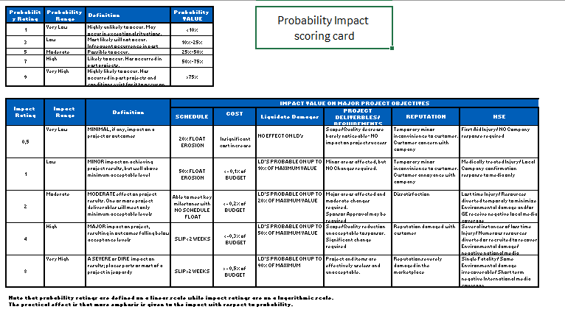
Probability Impact Scoring table
This is an information matrix and it is part of the Risk & Opportunity Register
Question1 : Do you need to keep this matrix configurable by the PMs/Risk Managers in the front end or can we keep the logics in backend?
Question2 : Is it ok to show the Risk/Opp.ty as a pop-up in the Risk Register or do you need a specific tab visible to all?

Slide 12
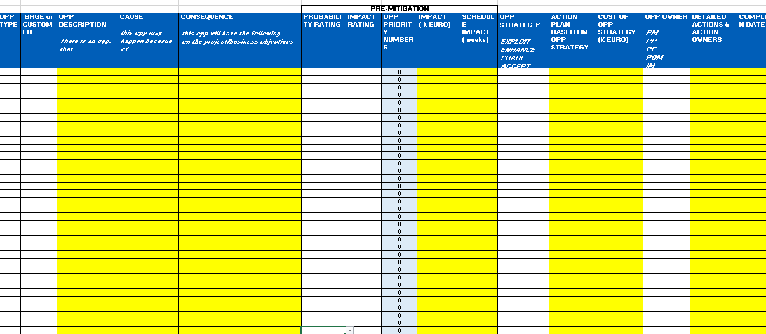
5. Opportunity Register
Need: The PM inputs manually the opportunities identified using a data-form.
Each line shall have the Edit icon (similar to Installation Dashboard)
White columns = drop down list
Yellow columns = free text
Light blue columns = calculated
Excel download
USERS ACCESS TO THE WIDGET:
PM - the Pm needs to have the capability to input manually free text in column 3, save draft, publish
All other roles – read only published version
Save draft
Publish
log
Question1 Is it entirely manually maintained? - YES
Question2 : Do we have any external Customer visibility use case?- THE COLUMN TO SEGREGATE INTERNAL (BHGE) OR CUSTOMER IS ALREADY PRESENT

Slide 13
MVP1 5. Opportunity Register data-form - Editing
OPPORTUNITY REGISTER DATA FORM
Input dataform for each oppty line of the Oppty Register.
OPPORTUNITY REGISTER DATA FORM
log
Save draft
Publish
< Previous
Next >
it is opened by the PM by clicking on a single row of the Risk Register and it is used to review and edit the risk lines. PM selects values from drop down lists or writes pn the free text fields:
COLUMNS/FIELDS IN WHITE COLOR – DROP-DOWN
COLUMNS/FIELDS IN YELLOW COLOR – FREE TEXT
2 COLUMNS/FILEDS WITH CALCULATION (MULTIPLIERS) AND COLORS AS PER THE Probability-Impact Matrix
Probability-Impact Matrix
Values are calcualted:
PROBABILITY RATING * IMPACT RATING
Colors shall change as per the Prob.-Impact Matrix

Slide 14

Risk/Opp.ty Matrix
This is an information matrix and it is part of the Risk & Opportunity Register
Question1 : Do you need to keep this matrix configurable by the PMs/Risk Managers in the front end or can we keep the logics in backend?
Question2 : Is it ok to show the Risk/Opp.ty as a pop-up in the Risk Register or do you need a specific tab visible to all?
NO , THIS MATRIX IS JUST FOR REFERENCE AND NEEDED FOR LOGIC - keep the logics in backend TO BE MODIFIED ONLY BY RISK OWNER

Slide 15
Excel Template file
PROBAB_IMPACT SCORING CARDS—matrix for INFO
PROB. & IMPACT MATRIX– matrix for INFO
CONTEXT CARDS - PM shall write on the free text fields
CHECK LIST FINAL--- list of questions with pre-defind fields, which is editable only by the Risk Owner/Risk Manager. The PM will be able to select the answer to the question YES/ NO—COLUMN D
This Check list is an auxiliary tool to the PM for the risk management and as a source to fill in 3 fields of the Risk register.
RISK REGISTER- This is the registry of the risk exisitng for the project. PM creates it from the Check list (where rows = Yes) or by adding new risks manually.
COLUMNS IN WHITE COLOR – ORIGINATE FROM THE RISK DATAFORM DROP-DOWN FIELDS
COLUMNS IN YELLOW COLOR – FROM THE RISK DATAFORM FREE TEXT FIELDS
2 COLUMNS WITH 0- CALCULATION (MULTIPLIERS) AND COLORS AS PER THE Probability-Impact Matrix - FROM THE RISK DATAFORM
The command IMPORT FROM CHECK LIST - it is a macro which imports 3 fields from the Check List for those rows where the answer is selected as YES ( CHECK LIST FINAL)
RISK REGISTER DATA FORM – it is opened by the PM by clicking on a single row of the Risk Register and it is used to review and edit the risk lines. PM selects values from drop down lists or writes pn the free text fields:
COLUMNS/FIELDS IN WHITE COLOR – DROP-DOWN
COLUMNS/FIELDS IN YELLOW COLOR – FREE TEXT
2 COLUMNS/FILEDS WITH 0- CALCULATION (MULTIPLIERS) AND COLORS AS PER THE Probability-Impact Matrix
OPP REGISTER- PM selects a pre-defined filter or writes on free text fields
Link to the Excel Template file

Slide 16
Data Storage - tbc
6. Massive download
A job to run from the front end shall allow to downloaded the last version of the Risk and Oppty registers for all projects exsiting in RealTrack.
Entire dataset of Risk Register and Opportuinity Register will need to be stored in a data-base ... With a certain rythm ... tbc

Slide 17
RealTrack Deliverables – MVP2
Context Card
Super user/Risk Manager shall be able to edit, cancel or add rows to the entire view in a sort of administration page, so that all projects will have an updated Context Card.
Check list
Super user/Risk manager shall be able to edit, cancel or add rows to the entire view in a sort of administration page, so that all projects will have an updated Check list.
Risk Register
Although could be a need, the Super user/Risk manager will not be able to edit, cancel or add columns the entire view: because the RR has a data-form for input data, the change of the Risk Register will require new developments ....:::
Opportunity Register – Risk manager shall be able to edit, cancel or add columns the entire view as it a sort of template. New columns and drop down list will be visible for all projects on all saved risk register

